Slide 1
Emotion Based Music Recommender Using Artificial Intelligence
Project by:-
Abhishek kumar
Akhilesh Singh
Akshit Verma Faculty:- Mr. Bhupender Bhadana

Slide 2
INTRODUCTION
Emotion recognition System is an application of AI & ML.
AI can detect emotion of function through Emotional expressions.
In this project , we have use facial expression to detect emotions of individual and play music according their expressions. It is basically a Python flask application with application of AI.
Facial recognition is a technique used for verification, identification and emotion detection of a person by analyzing and relating patterns based on the person's facial features.
AI based emotion recognition systems use machine learning algorithm such as CNN and RNN.

Slide 3
Objective
The objective of face emotion recognition (FER) is identifying emotions of a human.
In this project, we will be combining multiple services and open-source tools to make a Python flask application that play songs based on the expression of user.
Facial Emotion Recognition (FER) is the technology that analyses facial expressions from both static images and videos in order to reveal information on one's emotional state.

Slide 4
Conclusion
Facial expression is seen as the primary mode of recognition of human emotion.
It works on facial motion and the deformations of facial features to classify them into emotion categories.
Facial Emotion Recognition (FER) is the technology that analyses facial expressions from both static images and videos in order to reveal information on one's emotional state

Slide 5
Goals
The goal of emotion recognition is to classify an individual's emotional state based on their facial expressions, tone of voice, and other behavioral cues.
This technology is often used in various applications, such as marketing, customer service, mental health, and security.
Emotion recognition can be applied in security system to identify suspicious or potentially dangerous behaviors based on detected emotions.
It also can be used in Mental health applications to monitor and assess individuals emotional state over time.

Slide 6
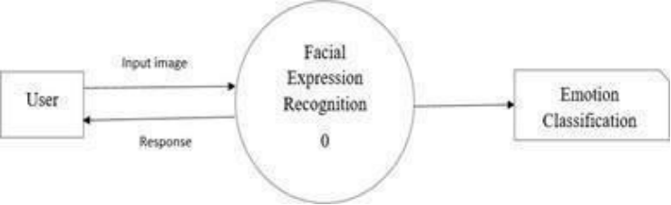
Zero level DFD

Slide 7
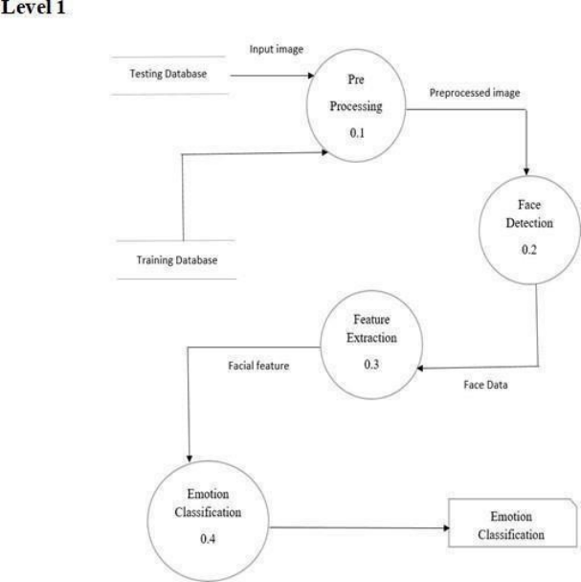
First Level DFD

Slide 8
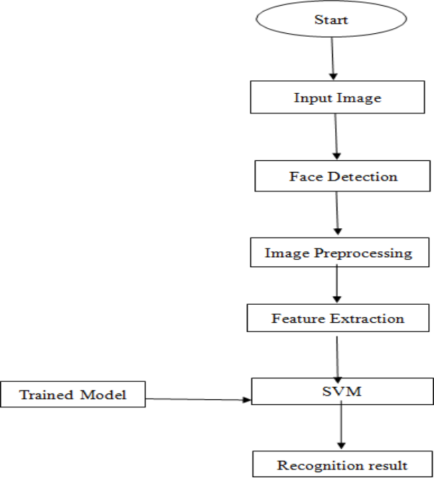
Flow Chart Diagram

Slide 9
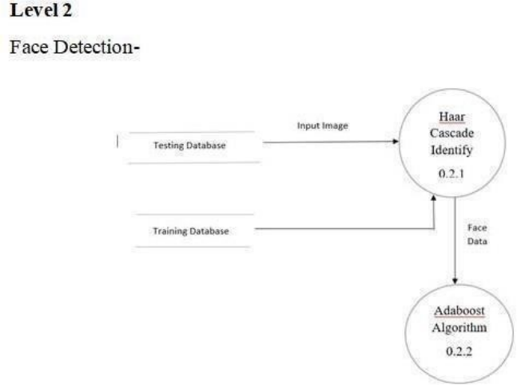
Second Level DFD

Slide 10
System Requirement And Specification

Slide 11
Software Requirement
VSCode:
Json
Python
Pandas
OpenCV
OS Window
HTML
Python Flask
Local Host
CSS
WSGI

Slide 12
VS Code
Visual Studio Code is a streamlined code editor with support for development operations like debugging, task running, and version control.
It aims to provide just the tools a developer needs for a quick code-build-debug cycle and leaves more complex workflows to fuller featured IDEs, such as Visual Studio IDE.

Slide 13
Hardware Requirement
2.0GHz AMD A4-9425 64bit PROCESSOR
2. 4GB / 8GB RAM
3. WEBCAM
4. 5GB HARD DISK SAPCE

Slide 14
Local Host
Localhost is a hostname that refers to the local machine currently making the request.
On many computers, localhost is an alias for the IP address 127.0. 0.1. When a computer pings this IP address, it is communicating with itself.
Local host is the current host in which you are logged in.
Just like HTTP and HTTPS , the localhost is a protocol. Remember that the website domain name is what follows the http or https.
In Windows 10 the hosts file is located at c:\Windows\System32\Drivers\etc\hosts.

Slide 15
Most used Python Library
The following Packages / modules are used in this project:-
NumPy
2. OpenCV
3. WSGI
4. Pip
6. Flask

Slide 16
NumPy
NumPy is a Python library used for working with arrays.
It is short on numerical python. It is known for its high-end performance with powerful N- dimensional array objects and the tools it is loaded with to work with arrays.
NumPy consumes less memory as compares to pandas.
NumPy seamlessly integrates with other scientific computer library such as SciPy, Pandas and a matplotlib.
NumPy plays a crucial role in face recognition applications by providing efficient array operations and mathematical or handling facial image data.

Slide 17
OpenCV
OpenCV (Open Source Computer Vision Library) is an open source computer vision and machine learning software library.
OpenCV allow you to perform several functionalities that are commonly utilized in face recognition systems:
I) Face detection
II) image processing
III) Feature extraction
Iv) Face recognition Algorithms
V) Real-Time Face Recognition
Vi) Visualization and Display

Slide 18
Flask
Flask is a lightweight and flexible web framework for Python. It is designed to be easy to use and provides the necessary tools and feature to build web applications quickly and efficiently.
Flask is known for its simplicity and easy of use , making it an excellent choice for beginners and developers who want to quickly prototype web applications.
Flask with WSGI servers:- Flask is compatible with various WSGI servers which allows it to be deployed in different production environment.

Slide 19
WSGI
WSGI refers to Web Server Gateway Interface. WSGI plays a vital role at the time when you deploy your Django or Flask application.
WSGI is a specification that describes the communication between web servers and Python web applications or frameworks.
WSGI allows web servers to communicate with web applications written in python. It provides as standard way for a web servers to forward HTTP requests to python applications and receive HTTP responses back. This enables developers to write web applications and receive HTTP responses back. This enables developers to write web applications that can be deployed on various web servers without being tightly coupled to any specific server technology.

Slide 20
PIP
PIP allows you to install packages from Python Package index(PyPI) or package repositories.
PIP automatically handles packages dependencies, ensuring that all package are installed when you install a package.
PIP makes it easier to upgrade packages to newer version.
PIP provides a simple way to uninstall packages.
PIP integrates with tools like virtualenv and venv to create and activate virtual environments.

Slide 21
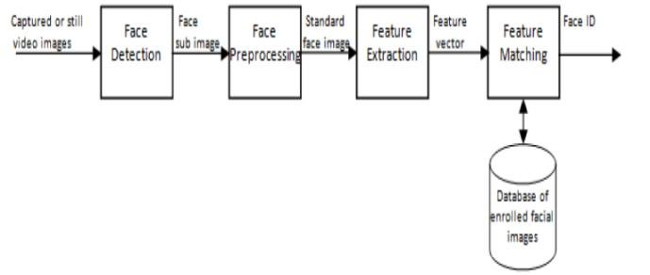
Phases in Emotional Recognition
Image Acquisition:- Images used for facial expression recognition are static images or image sequences. Images of face can be captured using camera.
Face Detection:- Face detection refers to the automated process of locating and identifying human faces within a digital image or video
Image Preprocessing:-
Feature Extraction

Slide 22
Project Snapshots​

Slide 23
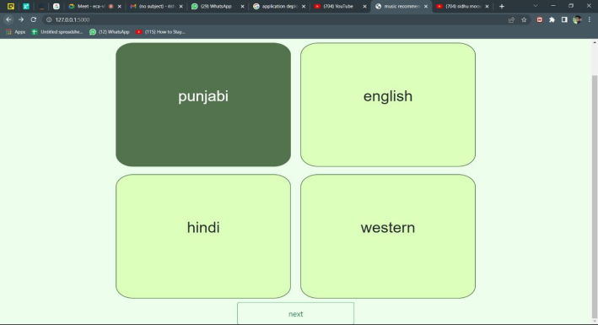
First Step
It is the first interface of the screen, where user have select any one in which He/she can Play song according to their mood.

Slide 24
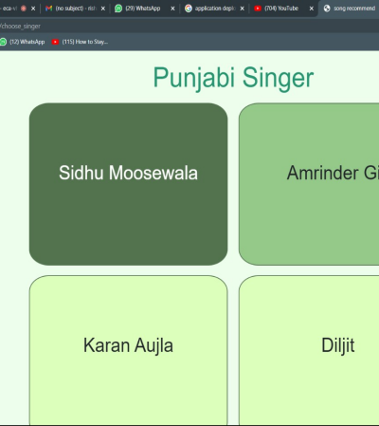
Second Step
After selecting the language, it comes to the second step where user can choose the singer according to their interest.

Slide 25
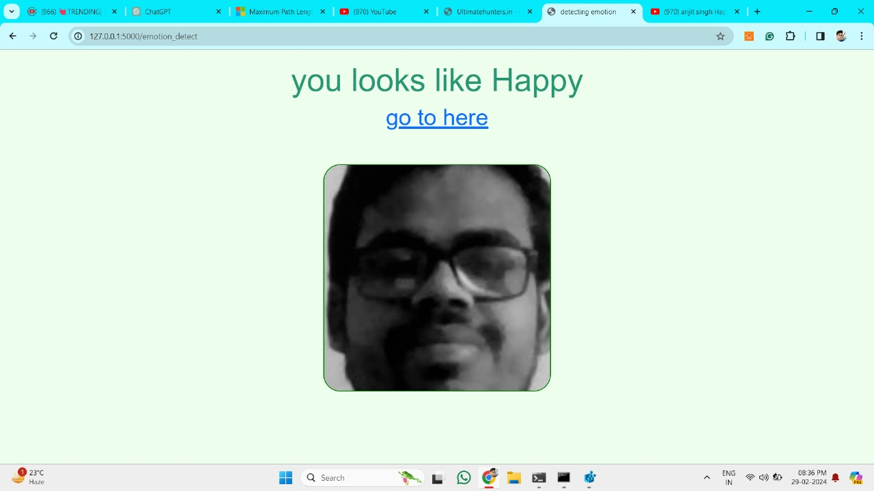
Third step
Here, Flask application recognizing the face on basis of emotion.

Slide 26
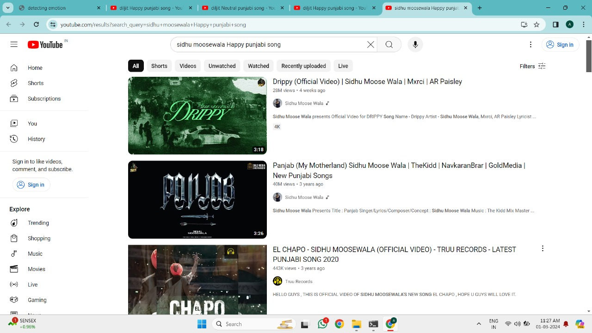
Final step
Finally, it comes to the last step where user get list of songs. Now He/she can play any one of them at time.

Slide 27
Future Scope
Algorithm Refinement: Continuously improve algorithms for more accurate emotion detection and better song recommendations.
Integration with Music Platforms: Collaborate with music streaming services to integrate the recommender system directly into their platforms.
Mobile Application Development: Create mobile apps to make the recommender system accessible to a wider audience on smartphones and tablets.
Expansion to Other Media Forms: Explore extending recommendation capabilities beyond songs to include movies, TV shows, and other media types.
Wearable Device Integration: Explore integrating the system with wearable devices to monitor users' emotions continuously and provide timely recommendations.
Real-time Emotion Detection: Implement real-time emotion detection to provide instant song recommendations based on users' current moods.

